Slide 1
The church of the epiphany
Stewardship 2025
Kick-off: Sunday September 15, 2024
Notes:
For those of you who don’t know me, my name is Gabriel Rueda, and I’m one of the members of the Bishop’s Committee
My partner, Christopher, and I joined TCOTE 19 years ago, in 2005, and we’ve served in different capacities, including BC, Finance Committee, EYG, RDV Board, Lectors, and several other Ministries
Earlier this year I volunteered to lead the Stewardship Campaign –a very coveted role (not) -- not knowing that my life circumstances would change
The fact this that later this month we will be moving to Florida and, much to our sadness, no longer be part of TCOTE
So, I few weeks ago I talked to Jamie and the BC because I felt that it might be a bit disingenuous to ask my congregation to pledge when I was no longer be here in 2025 – in other words, I tried to get out of this commitment and, as you can see… I clearly failed!
But seriously, the reason Jamie and Karen and others asked me to still be here today talking to you is because I believe (perhaps even more than I did 19 years ago) in what we do as a church and as a congregation
So if you take anything away from my (short) presentation today is this: PLEASE PLEDGE… it’s important to you, and it’s important to the congregation.
Let me try to explain WHY

Slide 2
Budgeting is an annual process critical to our operation
Pledging is at the core of that process
OPERATING INCOME: Where does the money come from?
OPERATING EXPENSES: Where does the money go to?
Our Budget Gap is covered by drawing from our Savings every year
Notes:
BTW, Questions are welcome and encouraged, and will have a Q&A at the end of this (short) presentation
This presentation has two parts: one ANALYTICAL and one SPIRITUAL
So, let me start the first part with Budgeting. Budgeting is an annual process that is critical to our operation as a church and Pledging is at the core of that process
Our Income comes from different sources but (using 2024 as an example), more than 60% of it comes from Pledge & Plate donations
Our Expenses go to support our Staff, pay our mortgage, maintaining our buildings and grounds and pay taxes and utilities
Only a small portion (6%) goes to Diocese support
In exchange for that support, the Diocese provides support to us (example)
There is a shortfall between our Income and our Expenses, which we cover by drawing from our Savings / Investments
We’ll talk about that GAP in a minute, but in 2024 that gap represented 14% of our budget
If there is one takeaway from all these numbers and graphs, is that every time our Income cannot cover our Expenses, we are chipping away from our Reserves… which of course we cannot continue to do forever.

Slide 3
Our Budget gap percentage has increased to double-digits in the last few years – Despite significant expense reductions
3%
0%
7%
Recent Expense Reductions
7%
20%
16%
11%
14%
Utilities
Insurance
IT costs
Office administration
A small change in our pledging habits will have a large impact
Notes:
Our budget is significantly lower than what it was a decade or more ago:
Our Income has decreased ~25% (proportionally more than our Expenses)
Our Expenses have decreased ~15%
Because our Income has decreased more than our Expenses, our Budget Gap is now higher, i.e. double-digit percentage (you can see the larger dip in the second set of bars on the right, compared to those on the left)
The good news is that a small change in our Pledging habits could make a large impact

Slide 4
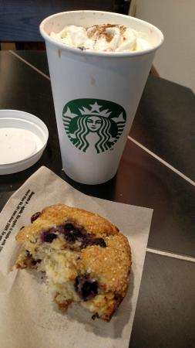
Our attendance has been increasing steadily
over the last four years
However, our giving (per person attending) has declined
*
* P&P = Pledge and Plate
If every person who comes to church regularly increases their pledge by the equivalent of two lattes & a scone per week… we’d significantly reduce the budget gap!
Notes:
Our Average Sunday Attendance (ASA) took a significant hit after 2017 and then again during COVID
It reached a low point in 2021, and now it’s slowly climbing up again (BLUE BARS)
Our Giving (i.e. Pledge & Plate) per person attending, however, been steadily declining
1. If every person (man, woman or child) who regularly comes to church would increase their pledge by just the equivalent of a couple of fancy coffees and a snack at Starbucks (or your favorite coffee shop) our Gap would disappear.

Slide 5
What is stewardship giving,
and why is pledging so important?
Stewardship Giving is…
Pledging is important because…
A gift of your TIME, TALENT and TREASURE for building God’s kingdom on Earth
An act of faith and an expression of gratitude for the gifts that God has given us
A recognition of our responsibility to care for this congregation – for one another!
An opportunity to grow, to learn to give as God has given, freely and generously
Pledge & Plate continues to be the main source of income of this church
Pledging help us plan and budget our activities throughout the year
It allows us to make commitments to help beyond the boundaries of this church (outreach)
Although it’s a promise, it’s not a liability should your circumstances change during the year
Pledging is an important part of our spiritual journey,
individually and as a congregation
Notes:
Moving away from cold numbers and into the more spiritual side of Giving, let’s take a look at why Stewardship is important:
Let’s also agree on why Pledging is important
In Conclusion: Giving is an important part of our spiritual journey,
individually and as a congregation

Slide 6
our generous giving of time, talent and treasure
can make a difference in the world
OUTREACH: The Church of the Epiphany supports:
Ministries
Conejo Compassion Coalition
Harbor House
Laundry Love
The Episcopal Church in Navajoland
Episcopal Relief & Development
Older Wiser Laity (OWLS)
Parents & Families of Lesbians & Gays
Red Door Vineyard (RDV)
Epiphany Music Guild (EMG)
Creation Care
Interfaith Ministry
Outreach and Ministries is a visible expression of our Church’s mission:
“… to serve the world with gratitude, humility, and courage and continue to grow in faith…”
Notes:
Beyond “keeping the light on”… our generous giving enables outreach activities and multiple ministries
Some of them have been around for a long time, such us OWLs
But we also have new and important ministries that we want to nurture and grow, such as Creation Care and Interfaith
As a matter of fact, Outreach and Ministries at are the core of our mission statement at TCOTE

Slide 7
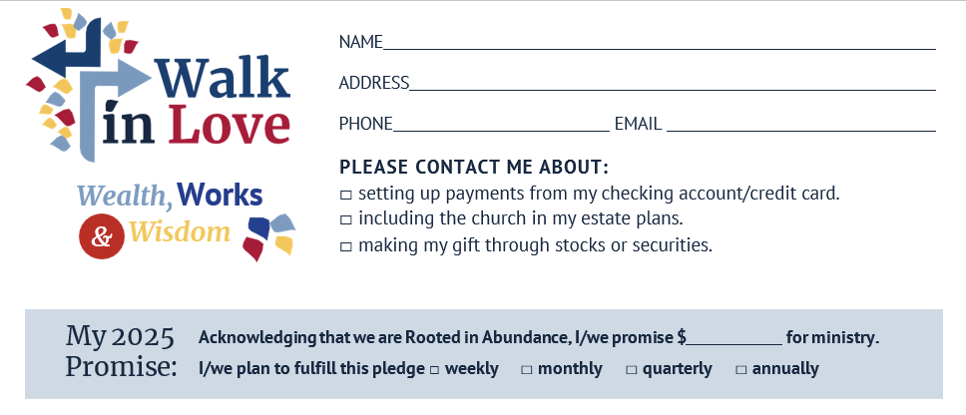
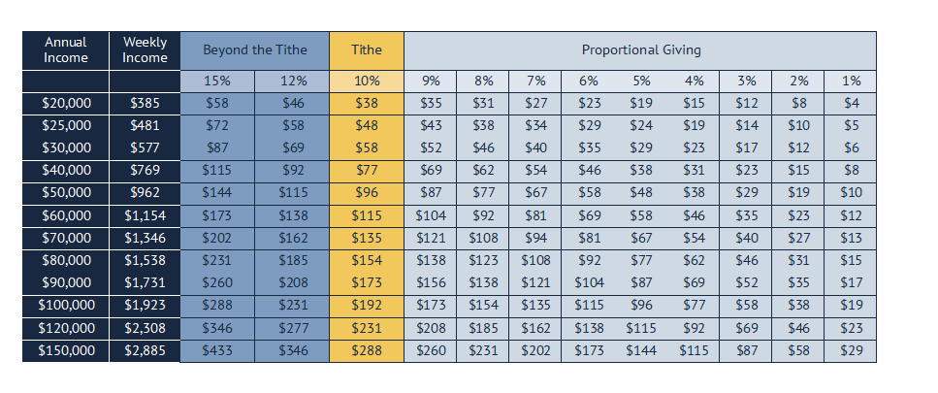
How do we pledge?

Slide 8
How do we fulfill our pledge?
There are four ways you can pay your pledge
Putting checks in the collection plate on Sunday
– Please write “Pledge” on the memo line of your check
Mailing checks to the church: 5450 Churchwood Dr., Oak Park, CA. 91377
– Please write “Attention of Michelle Ponticelli”
Paying electronically
– If you need help to set up, please contact Michelle Ponticelli
Paying by automatic payment
– You can set up a direct bill pay via the online bill pay services of your bank
– If you need help to set up, please contact Michelle Ponticelli
Notes:
Paying electronically or by automatic payment are the preferred method.
ELECTRONICALLY: You can set up a direct “bill pay” via the online “bill pay” services of your bank. This is the electronic equivalent of writing a check.
It will save you time, especially when you are out of town, and it is fast, direct, and saves trees!
The contact details you need to set up the church as an online “bill pay” account with your bank are: The Church of the Epiphany, Oak Park – 5450 Churchwood Dr., Oak Park, CA. 91377-.
If you have never used this service before, simply go to your bank’s webpage and click on a tab for online banking or online “bill pay”. You will then be walked through the set up
Or, contact Michelle Ponticelli at the church and she will help you set this up.
AUTOMATIC PAYMENT: is a transfer of money directly from your bank account into GHTC’s bank account. If you are interested in this, Michelle Ponticelli will help you set it up.

